Slide 1

Compatible Pair Problem
Advanced Algorithm and Complexity Term project
Kushal Chakraborty (2022H1030089H)
Muhammed Avesh Husain (2022H1030090H)
Aritra Kumar Dutta (2022H1030096H)

Slide 2
Overview
Introduction
Application
Assumptions and Notations
Illustration
Pseudo Code
Time Complexity

Slide 3
Introduction
Compatible Pair Problem aims to resolve the issue of compatibility from a given set of items.
It revolves around the assumption that entities has some liking for other entities as well some dislikes
This like and dislike is quantified into some number constraints namely likes and dislikes.
This algorithm uses Greedy Method to optimize the pairing problem for the best solution.
The algorithm revolves around picking up the most disliked item paired with another item who has liking for the former in every iteration.

Slide 4
Survey of Previous Work
The problem is derived from two very well known problems in the fields of Assignment and matching, namely Hungarian Algorithm for assignment problem and Stable Marriage/Matching Problem.

Slide 5
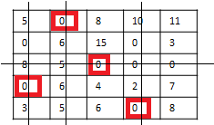
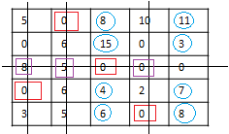
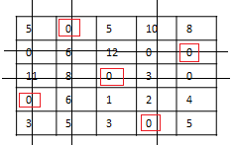
A brief look into Hungarian Algorithm
It’s a combinatorial optimization problem for solving Assignment problem.
Algorithm
A=input Matrix (n x n)
While(N<n) do
Do row reduction in A
Do column reduction in A
Draw N number of lines as
Row Scanning
Column scanning
13 | 8 | 16 | 18 | 19
9 | 15 | 24 | 9 | 12
12 | 9 | 4 | 4 | 4
6 | 12 | 10 | 8 | 13
15 | 17 | 18 | 12 | 20
Solution set
{8,12,4,6,12}
{B,E,C,A,D}
5 | 0 | 5 | 10 | 8
0 | 6 | 12 | 0 | 0
11 | 8 | 0 | 3 | 0
0 | 6 | 1 | 2 | 4
3 | 5 | 3 | 0 | 5
If N<n:
x=smallest uncovered element.
Update uncovered value=uncovered value-x
Update Intersection Value = Intersection Value+x
End While
Pick up boxed zero from every row and assign corresponding job in the solution set.
Return Solution Set.

Slide 6
Stable marriage problem
N men and N women are matched with each such that they are matched with their most preferred counterpart.
Problem is defined as 2n * n matrix
Each column of the matrix represent number of man or women
Rows i->n will contain preference given by n man
Rows (n+1) to 2n will contain preference given by n women
Gale–Shapley algorithm is used to solve the problem–Shapley algorithm

Slide 7
Gale - shapley algorithm
while there exist a free man m who still has a woman w to propose to
{
w = m's highest ranked such woman to whom he has not yet proposed
if w is free
(m, w) become engaged
else some pair (m', w) already exists
if w prefers m to m'
(m, w) become engaged
m' becomes free
else
(m', w) remain engaged
}
Problem Representation
W1 | W2
W2 | W1
M1 | M2
M1 | M2

Slide 8
Compatible Pair Problem using graph algorithm

Slide 9
Assumptions and Notations
The Graph G is a quintuple construct, G(E, V, W, L, D), Where the symbols represent:
Edges, E = Edges representing like and dislike with other items
Vertices, V = Number of Items
Weight, W = sum of likes and dislikes
Likes, L = {l_{i}} = number of likes for student i
Dislikes, D = {d_{i}) = number of dislikes for student i
The likes and dislikes are directed edges with weight represented as likes or dislikes, i.e. if i likes or dislikes j then weight of their edge will be w_{ij}. Similarly if j likes i then their weight will be w_{ji}.
w_{ij}.
i
j
i
j
w_{ji}.

Slide 10
Assumptions and Notations
Neutral edges are added and represent that a student neither dislikes nor likes the said candidate with whom the edge has been formed.
The edge weight is quantified as follows:
Likes contribute a weight of 2
Dislike contribute a weight of -2
Neutral contribute a weight of 1
Further the per pair like and dislike is merged to form a undirected edge and the edge weight amounts to w_{ij} + w_{ji}
w_{ij}.
i
j
w_{ij} + w_{ji}
i
j
i
j
w_{ji}.

Slide 11
Illustration
Given is a table of 6 students in a class namely A,B,C,D,E and F displaying their preference and dislike for other candidates to form a 2 people group.
Students | Likes | Dislikes
A | B,C,F | E
B | A,C,E | D
C | A,E,F | D
D | A,B,C | E
E | A,B,F | D
F | B,D,E | C

Slide 12
Illustration
The following table for neutral edges and number of students like and dislike that student can be derived from the previous table as follows. This table will be used to form a complete graph of n(n-1)/2 edges.
Students | Likes | Dislikes
A | B,C,F | E
B | A,C,E | D
C | A,E,F | D
D | A,B,C | E
E | A,B,F | D
F | B,D,E | C
Students | Neutral | l_{i} | d_{i}
A | D | 4 | 0
B | F | 4 | 0
C | B | 3 | 1
D | F | 1 | 3
E | C | 3 | 2
F | A | 3 | 0

Slide 13
Illustration
The algorithm runs n/2 times and produces a solution set, S of n/2 edges which is initially empty, because there are n vertices and therefore number of pairs will be n/2.
The following graph can be obtained from the derived table.
4,0
B
3
Students | Neutral | l_{i} | d_{i}
A | D | 4 | 0
B | F | 4 | 0
C | B | 3 | 1
D | F | 1 | 3
E | C | 3 | 2
F | A | 3 | 0
4,0
4
3
0
4
3,1
A
4
C
0
3
3
3
0
3
3
F
D
4
0
1,3
3,0
E
-4
3,2

Slide 14
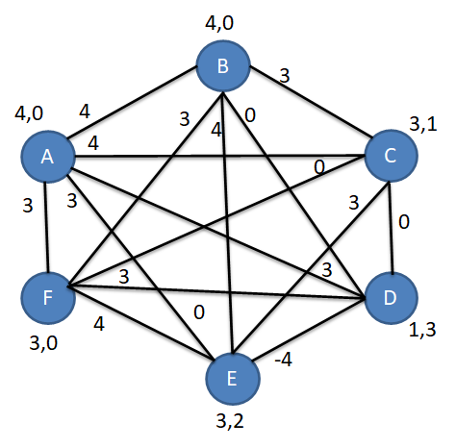
Illustration
First Iteration:
Pick up the most disliked student or vertex here, i.e. D and put it in a set called V1 if there are more than one then put it in another set V2.
Pickup the edge(s) which have the maximum weight incident on D, the reason why we are doing this, since D is the most disliked student or vertex, so its best chances of getting a partner is only with edges which have the maximum weight, since weight corresponds to sum of like and dislikes and dislike contribute to -2 weight. So we get edges, E₁={(A,D), (D,F)} as both have maximum weight of 3. Now we have to select one of edges among this two to be included in the solution set.

Slide 15
Illustration
First Iteration:
Now we have to choose one edge from E₁={(A,D), (D,F)}. First we will select the vertex with maximum dislike i.e. D and pair with someone with minimum likes among the two in the set because we want to have the more liked candidate free for other upcoming iterations so that all vertices can be paired, and most liked candidate will be more probable to be paired in upcoming iteration than one with less likes. Thus, most suitable candidate with such constraints will be F.
Thus (D,F) is best pair and hence added to the solution set S={(D,F)}.
Since (D,F) has been taken care of all the edges incident on (D,F) are removed along with the edge (D,F) and all the likes and dislikes edge weight contributed by (D,F) are subtracted and added to other vertices for likes and dislikes respectively.
So the new graph, is:
2,0
4
B
3
3,0
4
A
4
C
2,0
0
3
E
2,1

Slide 16
Illustration
Second Iteration:
Pickup the most disliked vertex, i.e. E
Pickup the most weighted edge incident on it, i.e E₁={(B,E)}.
Only one edge in E₁. So add it to the solution set, S={(D,F), (B,E)}.
And finally remove all edges and weights incident on (B,E).
So final graph becomes:
1,0
1,0
A
4
C

Slide 17
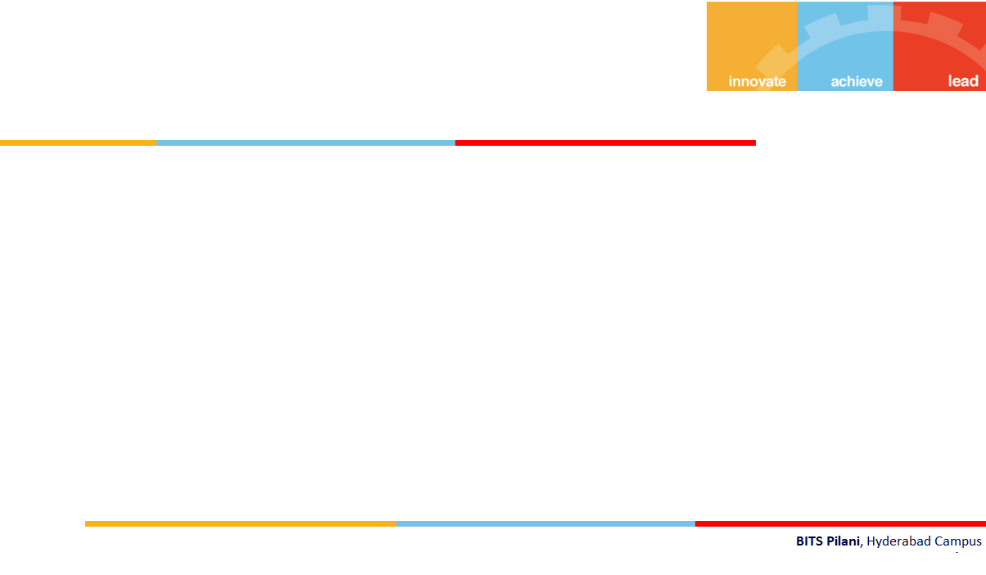
Illustration
Third Iteration
Only one edge left in the graph, which is selected and inserted into the solution set, S.
Thus S={(D,F), (B,E), (A,C)}. Is the final solution set.
1,0
1,0
A
4
C

Slide 18
Pseudo Code
Input: G’(E’, V’, W’, L’, D’) = G(E, V, W, L, D)
Output: S ⊂ E of n/2 disjoint edges with maximum total edge weight
S=Φ
for k =1,……n/2 do
Find V₁, set of nodes i ϵ V’ with max d_{i}
Find V₂, set of nodes i ϵ V₁ with min li
Find E₁ = {(i,j) ϵ E’, I ϵ V₂ or j ϵ V₂ with max w_{ij}}
Select (i,j) ϵ E₁ | I ϵ V₂ and j satisfies max d_{j} followed by min l_{j}
S = S ∪ selected (i,j)
V’ = V – (i,j)
E’ = E’ – {e ϵ E’ incident to i or j}
Update L’ and D’ accordingly
end for

Slide 19
Time Complexity
Recall our pseudo code
for k =1,……n/2 do
Find V₁, set of nodes i ϵ V’ with max d_{i}
Find V₂, set of nodes i ϵ V₁ with min li
Find E₁ = {(i,j) ϵ E’, I ϵ V₂ or j ϵ V₂ with max w_{ij}}
Select (i,j) ϵ E₁ | I ϵ V₂ and j satisfies max d_{j} followed by min l_{j}
end for
Takes n iterations for n vertices
Takes n² iterations since there are n(n-1)/2 edges
Thus , n+n² = O(n2)
But the entire for loop runs for n/2 iterations, thus, total time complexity is n/2 x O(n²) = O(n³)

